Slide 1
Predicting Flight Delays
Wendy Gao
Shon Inouye
Alex Wu
Andrew Zhang
Notes:
Andrew
Hi everyone, we are team Walk in the Spark. My name is Andrew.
*Everyone else introduces themselves*
Our project is predicting flight delays.

Slide 2
Executive Summary
Objective/Background
Preprocess dataset
Undersampled
Extracted 10% of dataset
Models in PySpark
Logistic Regression, Decision Tree, Random Forest
Model Performance/Results
Findings
Future Steps
Notes:
*This is high-level description of the problem, methods, data summary, findings*
Shon:
This is our executive summary of our slides. We’re going to walk you through our objectives and background, our preprocessing steps that includded undersampling, and fi

Slide 3
Objective
Data Preprocessing
Findings
Background
Predictive Models
Future Steps
Notes:
Shon

Slide 4
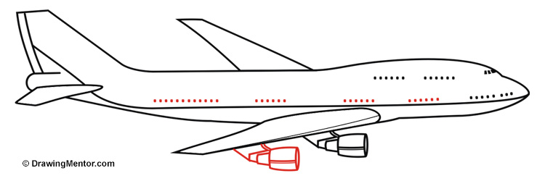
Objective
Identify factors that influence flight delays
Compare logistic regression, decision trees, and random forest models in predicting flight delays
Notes:
Shon
identify factors that are predictive of flight delays
compare different models to predict whether flight is delayed/cancelled

Slide 5
Objective
Data Preprocessing
Findings
Background
Predictive Models
Future Steps
Notes:
Shon

Slide 6
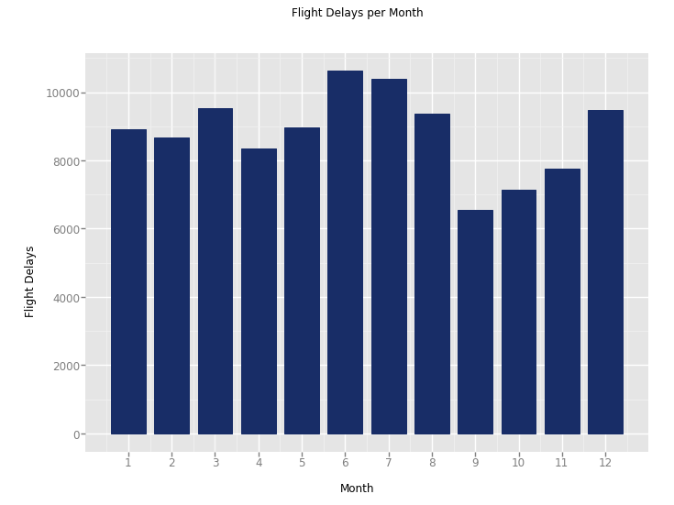
Background on Flight Delays
Two types of delays: Departure vs Arrival
Many factors responsible for delays:
“Weather” - Some airports more impacted by weather than others
“Reactionary” - delays caused by a late arriving flight, can impact the rest of the flights that day
“Airline” - Includes delays in boarding, baggage handling, aircraft maintenance
Other: airport, type of aircraft, etc
Notes:
Shon
***mention how weather delays can lead to reactionary delays at another airport
https://www.faa.gov/nextgen/programs/weather/faq/
http://www.eurocontrol.int/news/delays-three-questions-and-many-answers

Slide 7
Objective
Data Preprocessing
Findings
Background
Predictive Models
Future Steps
Notes:
Wendy

Slide 8
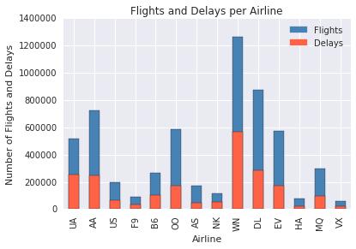
Dataset
2015 Flight Delays and Cancellation from Kaggle
Over 5 million observations
31 variables
Derived dependent variable
DELAY (Safe/Late)
Notes:
Wendy
Possibly put visuals here
[['DELAY','MONTH','DAY','DAY_OF_WEEK','AIRLINE','ORIGIN_AIRPORT','DESTINATION_AIRPORT','SCHEDULED_DEPARTURE','SCHEDULED_TIME','DISTANCE','SCHEDULED_ARRIVAL']]

Slide 9
Dataset
31 Attributes total, 9 Attributes used
Month, Day, Day of Week, Airline, Origin Airport, Scheduled Departure, Scheduled Time, Scheduled Arrival
Notes:
Wendy
Possibly put visuals here
[['DELAY','MONTH','DAY','DAY_OF_WEEK','AIRLINE','ORIGIN_AIRPORT','DESTINATION_AIRPORT','SCHEDULED_DEPARTURE','SCHEDULED_TIME','DISTANCE','SCHEDULED_ARRIVAL']]

Slide 10
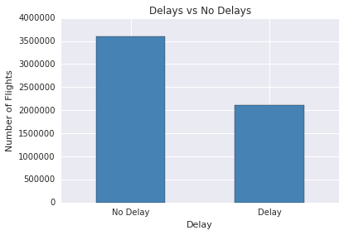
Preprocessing Steps
Removed incomplete observations
Balance dataset through undersampling
Sample 10% of the original data
Compared sample to original data
Notes:
Wendy
2:1 non-delays to delays

Slide 11
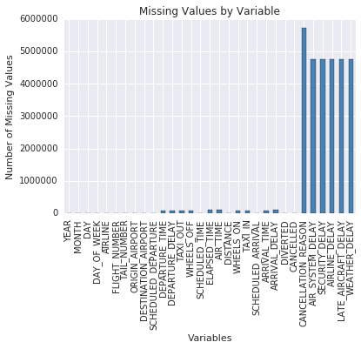
Preprocessing Steps
Input missing IATA codes (e.g. SFO, LAX) for October
Created binary variable: DELAYS
Relabeled categorical variables to integers
Notes:
Wendy
(We need to explain how we built DELAYS variable)

Slide 12
Objective
Data Preprocessing
Findings
Background
Predictive Models
Future Steps
Notes:
Alex

Slide 13
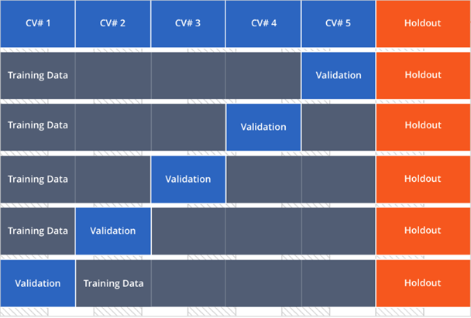
K-Fold Cross Validation
5-fold cross validation
20% holdout
Hyperparameters
0% 10% 20% 30% 40% 50% 60% 70% 80% 90% 100%
Notes:
Alex

Slide 14
Model No. 1: Logistic Regression
Tuning Parameters tried
elasticNetParam (α)
0.25, 0.75
regParam (λ)
0.01, 0.1
Coefficients of zero
“Day”
“Day of Week”
Elastic Net Logistic Regression (α = 0.25, λ = 0.01)
(Intercept) | 0.007875305905
MONTH | -0.0016188565602500
AIRLINE | -0.0001666416649080
SCHEDULED_DEPARTURE | 0.0000684187563015
ORIGIN_AIRPORT | -0.0002385724129090
SCHEDULED_TIME | 0.0001475330946790
DISTANCE | 0.0000183968092562
SCHEDULED_ARRIVAL | 0.0000563215212911
Notes:
Alex

Slide 15
Model Evaluation
Confusion Matrix for Logistic Regression
Specificity TN / (TN + FP)
≈ 0.5
Predicted NO when actually NO
Sensitivity TP / (TP + FN)
≈ 0.5
Predicted YES when actually YES
Precision TP / (FP + TP)
≈ 0.5
How often is it correct when predicted YES
n = 84817 | Predicted: NO | Predicted: YES
Actual: NO | TN = 42424 (50%) | FP = 2 (0%) | 42426 (50%)
Actual: YES | FN = 42390 (50%) | TP = 1 (0%) | 42391 (50%)
 | 84814 (100%) | 3 (0%) | 84817 (100%)
Notes:
Alex: Example confusion Matrix

Slide 16
Model No. 2: Decision Trees
Accuracy: 60.44%
Performed k-fold Cross Validation
Accuracy: 60.47%
~0.03% Improvement
Notes:
Alex
Random forests are ensembles of decision trees. They combine many decision trees to reduce the risk of overfitting. Random forests are used for regression and classification and can handle categorical features and can be extended to the multiclass classification setting. They do not require feature scaling and are able to capture non-linearities and feature interactions. Random forests are one of the most successful machine learning models for classification and regression.

Slide 17
Model No. 3: Random Forest
Accuracy: 59.9%
Performed k-fold Cross Validation
Accuracy: 60.7%
~0.8% Improvement
Notes:
Alex
Random forests are ensembles of decision trees. They combine many decision trees to reduce the risk of overfitting. Random forests are used for regression and classification and can handle categorical features and can be extended to the multiclass classification setting. They do not require feature scaling and are able to capture non-linearities and feature interactions. Random forests are one of the most successful machine learning models for classification and regression.

Slide 18
Model Performance Comparison
Model | Hyperparameters | Holdout Accuracy | K-Fold Accuracy
Logistic Regression | α = 0.25 λ = 0.01 | 0.500 | 0.500
Random Forest |  | 0.599 | 0.607
Decision Tree |  | 0.6044 | 0.6047
Notes:
Andrew
Here are the results from the 3 models we tried in spark. According to our results, we see that ___ performs the best with an accuracy of ___.

Slide 19
Objective
Data Preprocessing
Findings
Background
Predictive Models
Future Steps

Slide 20
Findings
Best model so far is Decision Trees with 60.4% accuracy
Our model predictions can still be improved
Parameter Tuning
K-fold cross validation
May need to include outside data like weather
Larger airlines tend to have more delays (ex. United Airlines, Southwest)
Notes:
Shon
Random Forest performed better than Decision Tree???

Slide 21
Objective
Data Preprocessing
Findings
Background
Predictive Models
Future Steps
Notes:
Andrew

Slide 22
Future Steps
Try other tuning parameters
Add parameters for k fold cross validation
Train current models with increased sample size
Train on other models
SVM
Notes:
Andrew
Continue tuning parameters for kfold
Work on kfold for Random Forest, Decision Tree
Look into SVM

Slide 23
Challenges
Limited by Spark 1.6.1 on Domino
Latest version of Spark
Debugging Spark
Data was dirty
Some airports did not have IATA codes (ex. LAX, SFO)
Notes:
Andrew
Issues running Spark 2.0 code
Missing October data
Data was super unclean(strings/ints mixed into one column)
Unbalanced data and tons of NA’s

Slide 24
Questions?

Slide 25
Appendix

Slide 26
Model Evaluation
Confusion Matrix for Logistic Regression
Specificity TN / (TN + FP)
≈ 0.41
Predicted NO when actually NO
Sensitivity TP / (TP + FN)
≈ 0.41
Predicted YES when actually YES
Precision TP / (FP + TP)
≈ 0.41
How often is it correct when predicted YES
n = 84817 | Predicted: NO | Predicted: YES
Actual: NO | TN = 17460 (20.6%) | FP = 24966 (29.4%) | 42426 (50%)
Actual: YES | FN = 24953 (29.4%) | TP = 17438 (20.6%) | 42391 (50%)
 | 42413 (50%) | 42404 (50%) | 84817 (100%)
Notes:
Alex: Example confusion Matrix

